Slide 1
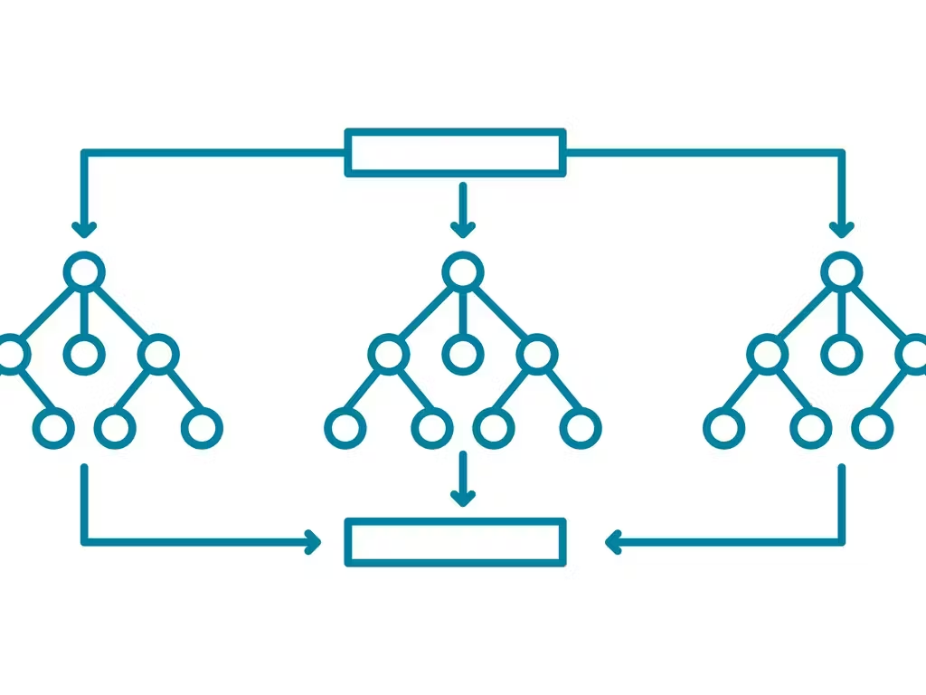
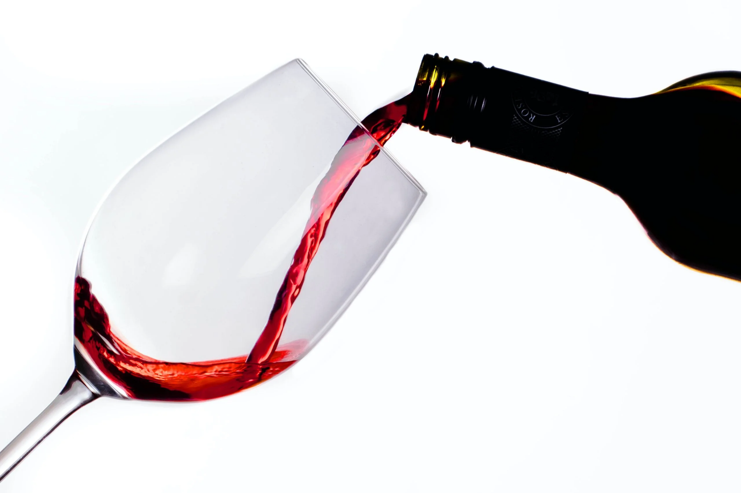
Wine Quality Prediction using Random Forests
Team Members:
Isaac Carr
Machaela Madsen
Maia Yang
Richard Kemonou

Slide 2
Project Scope
For this project we analyzed a wine database that contains different chemical characteristics of wine along with their quality ratings.
Techniques used:
SQL
Supervised Learning: Random Forests
Tableau
Matplotlib
Flask App

Slide 3
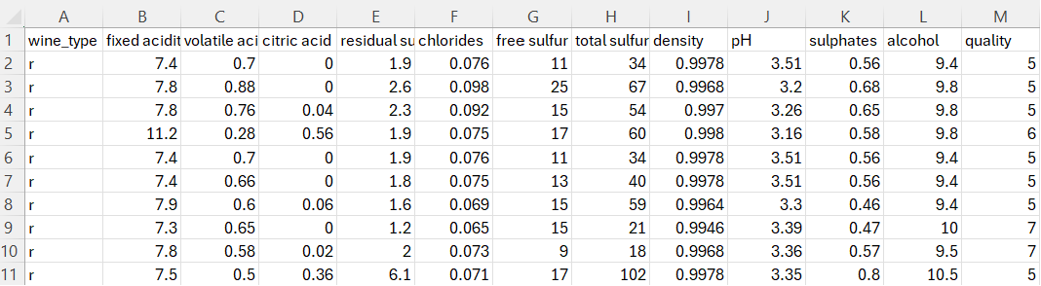
Data
Data Source: https://www.kaggle.com/code/margijiyani1/notebook093682bdb/input?select=winequality_white.csv
-We used 2 Datasets from Kaggle (Red and White Wine)
Combined them using SQL
Made an extra column labeling whether its Red or White Wine
-The data contained 11 columns of data that we used for our machine learning analysis to predict the quality of the Wine
- Over 6000 rows of
data

Slide 4
Model 1: Random Forests
Preprocess data:
Used pd.get_dummies to convert categorical values to numerical values
Used train_test_split to split data into training and testing datasets
Used StandardScaler() to scale data
Instantiate model, fit model, and make predictions:
Model was instantiated with 200 estimators
Model was fit using training data
Predictions were made on the X_test_scaled data using the model
Calculate model performance:
Confusion matrix and accuracy score

Slide 5
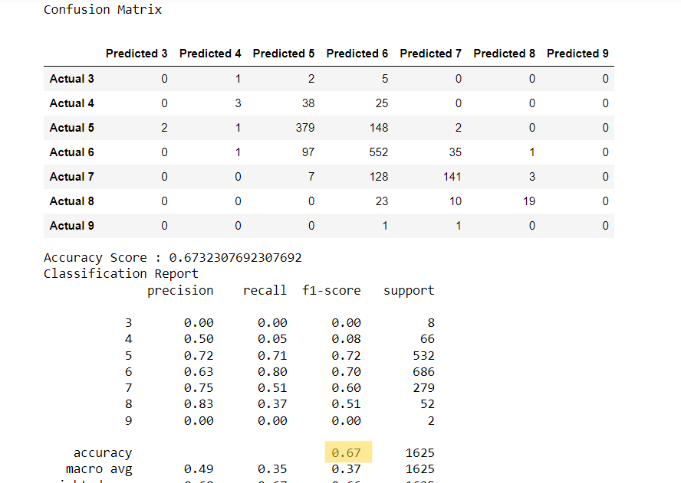
Model 1 Results and Optimization
Results:
Overall accuracy score of .67
4. Optimization:
Increased to 1000 estimators
Only increased accuracy score to .68
Imbalanced classes

Slide 6
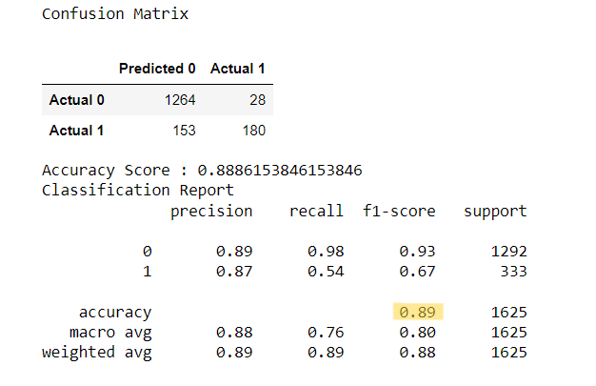
Model 2: Random Forests using Binary Classification
Wine quality column was binned into two categories:
-Good (value of 1): Rating of 7 or higher
-Bad (value of 0): Rating of 6 or lower
Repeated steps #1-3 from previous model
Results
An accuracy score of .89 was attained

Slide 7
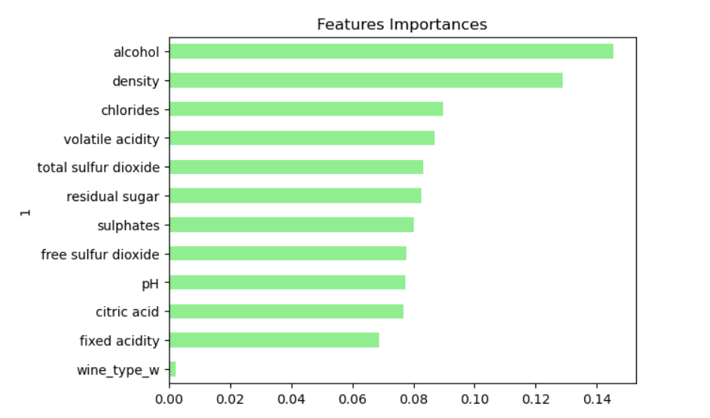
Features Importances

Slide 8
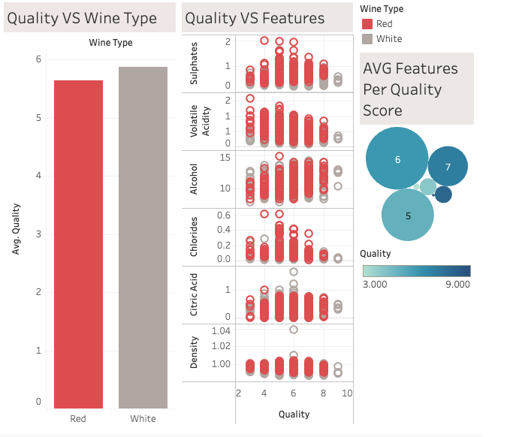
Dashboard
White wine has slightly higher average quality
White = 5.88
Red = 5.64
Strong correlations not seen between singular feature and quality
Highest quality achieved is 9

Slide 9
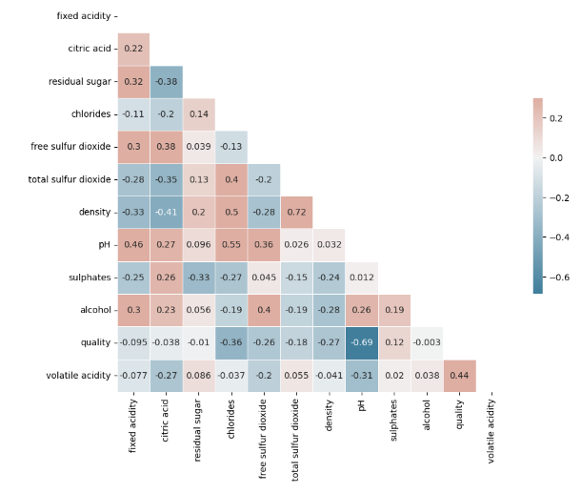
Heatmap uncovers wine property correlations.
Positive values mean direct relationships.
Negative values signify inverse relationships.
Example: Higher alcohol links to better quality, lower acidity to higher quality.
Key for pinpointing factors impacting wine quality.

Slide 10
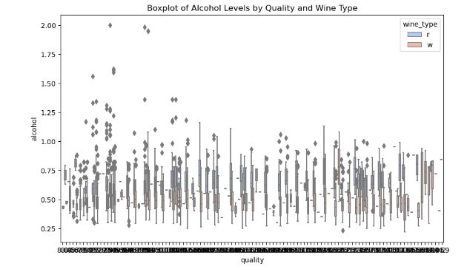
Visualization shows alcohol level distribution by wine quality ratings.
Wider interquartile ranges signal more alcohol content variation within a quality level.
Higher medians in quality ratings imply wines with more alcohol are often rated higher.
Outliers represent wines with alcohol levels far from their quality group's norm.

Slide 11
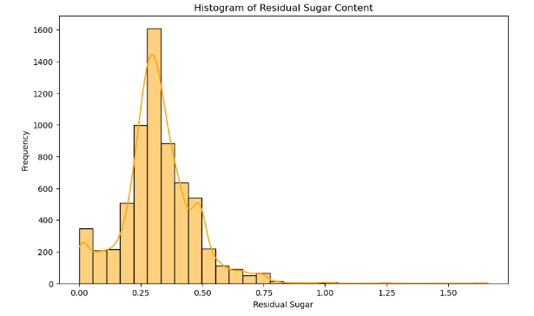
Displays residual sugar content distribution across wines in a histogram.
Skewed distribution hints at predominance of low sugar wines; fewer high sugar ones.
Histogram peaks reveal most common sugar levels; spread shows sweetness diversity.
Crucial for understanding sweetness variation and categorizing wines (dry, sweet, etc.).

Slide 12
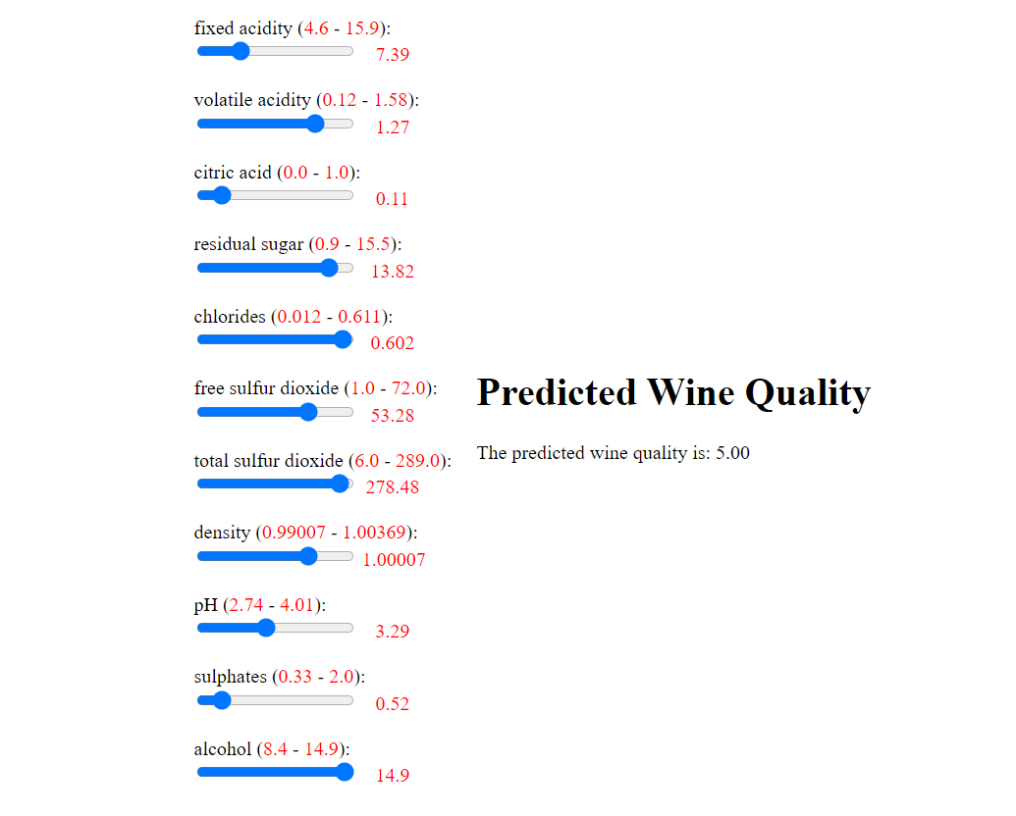
Wine Quality Predictor

Slide 13
In Conclusion…
We were able to optimize our model to achieve 89% accuracy
The model predicts wine quality based on chemical properties within CSV files
Notes to consider:
Our model achieving 89% accuracy predicts good or bad quality. It does not produce a numeric rating
The majority of wines fell into the 5-7 quality range

